Slide 1
MASTERS IN PROJECT MANAGEMENT
PROJECT RISK
MANAGEMENT
Class: MS(PM)-2(A,B&C)

Slide 2
Instructor
Suhail Iqbal
PE, PMP, PgMP, PME, MCT, PRINCE2 Practitioner.
PE, PMP, PgMP, PME, MCT, PRINCE2 Practitioner.
Notes:
Custom animation effects: horizontal scrolling text
(Basic)
To reproduce the text effects on this slide, do the following:
On the Home tab, in the Slides group, click Layout, and then click Blank.
On the Insert tab, in the Text group, click Text Box, and then on the slide, drag to draw the text box.
Enter text in the text box. (Note: You may want to add a bullet point at the end of your text, as in the example above. On the Insert tab, in the Text group, click Symbol. In the Symbol dialog box, in the Font list, select (normal text). In the Subset list, select General Punctuation. In the Character Code box, enter 2022 to select BULLET, and then click Insert.)
Select the text. On the Home tab, in the Font group, do the following:
In the Font list, select Gill Sans MT.
In the Font Size list, select 36.
Click Bold.
Click the arrow next to Font Color, and then under Theme Colors click White, Background 1 (first row, first option from the left).
On the Home tab, in the Paragraph group, click Align Text Left to align the text left in the text box. (Note: If the text wraps to more than one line, drag the adjustment handles on the text box to widen it until the text fits on one line.)
Drag the text box to the left of the lower left edge of the slide. (Note: To see beyond the edges of the slide, on the View tab, click Zoom, and then in the Zoom dialog box, in the Percent box, enter 40%.)
To reproduce the animation effects on this slide, do the following:
On the Animations tab, in the Animations group, click Custom Animation.
On the slide, select the text box. In the Custom Animation task pane, do the following:
Click Add Effect, point to Entrance, and then click More Effects. In the Add Entrance Effect dialog box, under Basic, click Fly In.
Select the animation effect (fly-in effect for the text box). Click the arrow to the right of the select effect, and then click Effect Options. In the Fly In dialog box, do the following:
On the Effect tab, in the Direction list, select From Right.
On the Timing tab, do the following:
In the Start list, select With Previous.
In the Speed box, enter 16 seconds.
In the Repeat list, select Until End of Slide.
On the slide, select the text box. On the Home tab, in the Clipboard group, click the arrow under Paste, and then click Duplicate.
In the Custom Animation task pane, select the second animation effect (fly-in effect for the second text box). Click the arrow to the right of the selected effect, and then click Timing. In the Fly In dialog box, on the Timing tab, in the Delay box, enter 8. (Note: You may need to adjust the delay time if the length of your text is different than the example above.)
On the slide, drag the second text box on top of the first text box.
On the Home tab, in the Editing group, click Select, and then click Selection Pane.
In the Selection and Visibility pane, press and hold CTRL, and then select both text boxes. On the Home tab, in the Drawing group, click Arrange, point to Align, and then do the following:
Click Align Selected Objects.
Click Align Middle.
Click Align Center.
To reproduce the background effects on this slide, do the following:
Right-click the slide background area, and then click Format Background. In the Format Background dialog box, click Fill in the left pane, and then select Picture or texture fill in the Fill pane. Under Insert from, click File. In the Insert Picture dialog box, select a picture, and then click Insert.
On the Home tab, in the Drawing group, click Shapes, and then under Rectangles click Rectangle (first option from the left). On the slide, drag to draw a rectangle.
Select the rectangle. Under Drawing Tools, on the Format tab, in the Size group, do the following:
In the Shape Height box, enter 7.5”.
In the Shape Width box, enter 1”.
Under Drawing Tools, on the Format tab, in the Shape Styles group, click the arrow next to Shape Outline, and then click No Outline.
On the Home Tab, in the Drawing group, click the arrow next to Shape Fill, point to Gradient, and then click More Gradients. In the Format Shape dialog box, click Fill in the left pane, select Gradient fill in the Fill pane, and then do the following:
In the Type list, select Linear.
Click the button next to Direction, and then click Linear Right (first row, fourth option from the left).
Under Gradient stops, click Add or Remove until two stops appear in the drop-down list.
Also under Gradient stops, customize the gradient stops that you added as follows:
Select Stop 1 from the list, and then do the following:
In the Stop position box, enter 0%.
Click the button next to Color, and then under Theme Colors click Black, Text 1 (first row, second option from the left).
In the Transparency box, enter 0%.
Select Stop 2 from the list, and then do the following:
In the Stop position box, enter 100%.
Click the button next to Color, and then under Theme Colors click Black, Text 1, (first row, second option from the left).
In the Transparency box, enter 100%.
On the slide, select the rectangle. On the Home tab, in the Drawing group, click Arrange, point to Align, and then do the following:
Click Align to Slide.
Click Align Left.
Click Align Middle.
Select the rectangle. On the Home tab, in the Clipboard group, click the arrow under Paste, and then click Duplicate.
Select the duplicate rectangle. On the Home Tab, in the Drawing group, click the arrow next to Shape Fill, point to Gradient, and then click Linear Left (second row, third option from the left).
With the duplicate rectangle still selected, on the Home tab, in the Drawing group, click Arrange, point to Align, and then do the following:
Click Align to Slide.
Click Align Right.
Click Align Middle.

Slide 3
SYLLABUS
Unit | Content | Learning Objectives
5. Risk Management Processes | Role of Project Risk Management in Project Management Project Risk Management Processes Plan Risk Management Identify Risks Perform Qualitative Risk Management Perform Quantitative Risk Management Plan Risk Responses Monitor and Control Risks | Understand the role of Project Risk management in the overall Project management and define specifically the Project Risk Management Processes

Slide 4
UNIT 5
UNIT 5
RISK MANAGEMENT PROCESSES
PROJECT RISK MANAGEMENT
Class: MS(PM)-2 (A,B&C)

Slide 5
RISK MANAGEMENT PROCESSES
LEARNING OBJECTIVE
UNIT 5
Understand the role of Project Risk management in the overall Project management and define specifically the Project Risk Management Processes
Notes:
RISK MANAGEMENT PROCESSES
LEARNING OBJECTIVE
Understand the role of Project Risk management in the overall Project management and define specifically the Project Risk Management Processes

Slide 6
RISK MANAGEMENT PROCESSES
CONTENT
UNIT 5
Role of Project Risk Management in Project Management
Project Risk Management Processes
Plan Risk Management
Identify Risks
Perform Qualitative Risk Management
Perform Quantitative Risk Management
Plan Risk Responses
Monitor and Control Risks
Notes:
RISK MANAGEMENT PROCESSES
CONTENT
Role of Project Risk Management in Project Management
Project Risk Management Processes
Plan Risk Management
Identify Risks
Perform Qualitative Risk Management
Perform Quantitative Risk Management
Plan Risk Responses
Monitor and Control Risks

Slide 7
ROLE OF PROJECT RISK MGMT
In Corporate Business Mgmt
UNIT 5
Two Basic Types in Corporate Business Management:-
Business Risk
Inherent chances of both profit and loss associated with the particular business endeavor.
Business entities employ skilled staff to increase the chances of profit and reduce the chances of loss.
The essential purpose is to maximize profits.
Pure or Insurable Risk
Involves only a chance for loss and no chance for profit.
Insurable risks can be further sub-divided into four categories:-
Direct property loss
Indirect property loss
Liability loss
Personal loss
From Project and Program Risk Management,
Max Wideman, PMI
Notes:
ROLE OF PROJECT RISK MGMT
In Corporate Business Management
Two Basic Types in Corporate Business Management:-
Business Risk
Inherent chances of both profit and loss associated with the particular business endeavor.
Business entities employ skilled staff to increase the chances of profit and reduce the chances of loss.
The essential purpose is to maximize profits.
Pure or Insurable Risk
Involves only a chance for loss and no chance for profit.
Insurable risks can be further sub-divided into four categories:-
Direct property loss
Indirect property loss
Liability loss
Personal loss

Slide 8
ROLE OF PROJECT RISK MGMT
In Corporate Business Mgmt
UNIT 5
Direct Property Loss - Destruction of property by:-
fire,
flood or
wind storm.
Indirect Property Loss - Somewhat more subtle and involves:-
Extra expenses associated with renting alternative temporary accommodation or equipment following its damage or destruction
Loss due to business interruption if operations cannot be continued because the replacement is not immediately available.
From Project and Program Risk Management,
Max Wideman, PMI
Notes:
ROLE OF PROJECT RISK MGMT
In Corporate Business Management
Direct Property Loss - Destruction of property by:-
fire,
flood or
wind storm.
Indirect Property Loss - Somewhat more subtle and involves:-
Extra expenses associated with renting alternative temporary accommodation or equipment following its damage or destruction
Loss due to business interruption if operations cannot be continued because the replacement is not immediately available.

Slide 9
ROLE OF PROJECT RISK MGMT
In Corporate Business Mgmt
UNIT 5
Liability Loss
Involves the chance of a member of the public filing a lawsuit for :-
bodily injury,
personal injury, or
property damage against the contractor.
Personal Loss
Involves injuries to employees such as those contemplated by Worker’s Compensation Laws.
From Project and Program Risk Management,
Max Wideman, PMI
Notes:
ROLE OF PROJECT RISK MGMT
In Corporate Business Management
Liability Loss
Involves the chance of a member of the public filing a lawsuit for :-
bodily injury,
personal injury, or
property damage against the contractor.
Personal Loss
Involves injuries to employees such as those contemplated by Worker’s Compensation Laws.

Slide 10
ROLE OF PROJECT RISK MGMT
Risk in Project Management
UNIT 5
All projects are uncertain
Uncertainty is inevitable since projects are:-
Unique and temporary undertakings based on assumptions and constraints
Delivering project results to multiple stakeholders with different requirements.
From Practice Standard for Project Risk Management, 1st Ed, PMI
Notes:
ROLE OF PROJECT RISK MGMT
Risk in Project Management
All projects are uncertain
Uncertainty is inevitable since projects are:-
Unique and temporary undertakings based on assumptions and constraints
Delivering project results to multiple stakeholders with different requirements.

Slide 11
ROLE OF PROJECT RISK MGMT
Risk in Project Management
UNIT 5
Project Management controls uncertainty
Project management is an attempt to control this uncertain environment through the use of structured techniques such as:-
Estimating
Planning
Cost Control
Task allocation
Earned Value Analysis
Monitoring and
Review Meetings etc.
Each of these elements of project management has a role in defining or controlling the uncertainty which is inherent in all projects.
From Practice Standard for Project Risk Management, 1st Ed, PMI
Notes:
ROLE OF PROJECT RISK MGMT
Risk in Project Management
Project Management controls uncertainty
Project management is an attempt to control this uncertain environment through the use of structured techniques such as:-
Estimating
Planning
Cost Control
Task allocation
Earned Value Analysis
Monitoring and
Review Meetings etc.
Each of these elements of project management has a role in defining or controlling the uncertainty which is inherent in all projects.

Slide 12
ROLE OF PROJECT RISK MGMT
Risk in Project Management
UNIT 5
Project Risk Management provides an approach
Project Risk Management provides an approach by which uncertainty can be :-
Understood
Assessed, and
Managed.
within projects.
It forms an integral part of project management.
Effective Project Risk Management is a critical success factor for project success.
From Practice Standard for Project Risk Management, 1st Ed, PMI
Notes:
ROLE OF PROJECT RISK MGMT
Risk in Project Management
Project Risk Management provides an approach
Project Risk Management provides an approach by which uncertainty can be :-
Understood
Assessed, and
Managed.
within projects.
It forms an integral part of project management.
Effective Project Risk Management is a critical success factor for project success.

Slide 13
ROLE OF PROJECT RISK MGMT
Risk in Project Management
UNIT 5
Project Risk Management not an option
For Project Management to be effective, Project Risk Management must NOT be considered as optional or an additional overhead task.
Since many elements of project management addresses inherent uncertainty.
The interface between structured Project Risk Management and the other processes of project management needs to be clear.
The outputs of Project Risk Management should be taken into account within many of the project management processes.
From Practice Standard for Project Risk Management, 1st Ed, PMI
Notes:
ROLE OF PROJECT RISK MGMT
Risk in Project Management
Project Risk Management not an option
For Project Management to be effective, Project Risk Management must NOT be considered as optional or an additional overhead task.
Since many elements of project management addresses inherent uncertainty.
The interface between structured Project Risk Management and the other processes of project management needs to be clear.
The outputs of Project Risk Management should be taken into account within many of the project management processes.

Slide 14
ROLE OF PROJECT RISK MGMT
Risk in Project Management
UNIT 5
The impact of Project Risk Management outputs
The outputs of Project Risk Management can impact:-
Estimating resource requirements, cost or duration
Assessing the impact of proposed scope changes
Planning or re-planning the forward strategy of the project
Allocating resources to tasks, and
Reporting progress to stakeholders
None of these actions can be performed properly without a clear view of the risk involved.
Project management processes effectiveness is increased by using the information and results from Project Risk Management.
From Practice Standard for Project Risk Management, 1st Ed, PMI
Notes:
ROLE OF PROJECT RISK MGMT
Risk in Project Management
The impact of Project Risk Management outputs
The outputs of Project Risk Management can impact:-
Estimating resource requirements, cost or duration
Assessing the impact of proposed scope changes
Planning or re-planning the forward strategy of the project
Allocating resources to tasks, and
Reporting progress to stakeholders
None of these actions can be performed properly without a clear view of the risk involved.
Project management processes effectiveness is increased by using the information and results from Project Risk Management.

Slide 15
ROLE OF PROJECT RISK MGMT
Risk in Project Management
UNIT 5
Outputs from Other Project Management Processes
Project Risk Management requires input from other project management processes.
Outputs such as :-
Work Breakdown Structure (WBS)
Estimates
Project Schedule
Assumptions list, etc.
are all important prerequisites for effective
Project Risk Management.
From Practice Standard for Project Risk Management, 1st Ed, PMI
Notes:
ROLE OF PROJECT RISK MGMT
Risk in Project Management
Outputs from Other Project Management Processes
Project Risk Management requires input from other project management processes.
Outputs such as :-
Work Breakdown Structure (WBS)
Estimates
Project Schedule
Assumptions list, etc.
are all important prerequisites for effective
Project Risk Management.

Slide 16
ROLE OF PROJECT RISK MGMT
Risk in Project Management
UNIT 5
The Responsibility
Responsibility of Project Risk is so pervasive that it is rarely given sufficient central attention.
Not all risk events are independent.
Total amount at stake on a project may be highly dependent upon series of interacting events.
“It never rains but it pours.”
A series of risk events frequently cross traditional functional responsibility boundaries:-
Causing Classic difficulty of coordination and rapid response
Can lead to disastrous consequences.
From Project and Program Risk Management,
Max Wideman, PMI
Notes:
ROLE OF PROJECT RISK MGMT
Risk in Project Management
The Responsibility
Responsibility of Project Risk is so pervasive that it is rarely given sufficient central attention.
Not all risk events are independent.
Total amount at stake on a project may be highly dependent upon series of interacting events.
“It never rains but it pours.”
A series of risk events frequently cross traditional functional responsibility boundaries:-
Causing Classic difficulty of coordination and rapid response
Can lead to disastrous consequences.

Slide 17
ROLE OF PROJECT RISK MGMT
Risk in Project Management
UNIT 5
Ultimate Responsibility
Ultimate responsibility for identifying risks to a project and their subsequent treatment must rest with the project sponsor.
The very threat posed to the successful achievement of project objectives should be sufficient reason for project sponsor to recognize this responsibility.
From Project and Program Risk Management,
Max Wideman, PMI
Notes:
ROLE OF PROJECT RISK MGMT
Risk in Project Management
Ultimate Responsibility
Ultimate responsibility for identifying risks to a project and their subsequent treatment must rest with the project sponsor.
The very threat posed to the successful achievement of project objectives should be sufficient reason for project sponsor to recognize this responsibility.

Slide 18
ROLE OF PROJECT RISK MGMT
Risk in Project Management
UNIT 5
A Particular Case
Project leader must keep the project on schedule
Must act with insufficient information to take decisions
Such risk must be calculated, not reckless
The absence of requisite information clearly recognized
Collection of the information is either too costly, or too time consuming or simply unavailable
It is advisable to have a contingency plan prepared so that when the information or results do become available, there is a “full-back” position to turn to.
From Project and Program Risk Management,
Max Wideman, PMI
Notes:
ROLE OF PROJECT RISK MGMT
Risk in Project Management
A Particular Case
Project leader must keep the project on schedule
Must act with insufficient information to take decisions
Such risk must be calculated, not reckless
The absence of requisite information clearly recognized
Collection of the information is either too costly, or too time consuming or simply unavailable
It is advisable to have a contingency plan prepared so that when the information or results do become available, there is a “full-back” position to turn to.

Slide 19
ROLE OF PROJECT RISK MGMT
Risk in Project Management
UNIT 5
In R&D Projects
Unknowns that can turn into unpleasant surprises may include:-
Technical solutions that do not works as expected
Experiments that fail
Un-anticipated by-products or side-effects, such as:-
Undesirable side-effects of a new drug
Being eclipsed by an unanticipated superior product announcement
By an overriding patent application by a competitor
Market research indicating lack of customer acceptance
Escalating product development costs
Product reliability, quality or producibility difficulties.
From Project and Program Risk Management,
Max Wideman, PMI
Notes:
ROLE OF PROJECT RISK MGMT
Risk in Project Management
In R&D Projects
Unknowns that can turn into unpleasant surprises may include:-
Technical solutions that do not works as expected
Experiments that fail
Un-anticipated by-products or side-effects, such as:-
Undesirable side-effects of a new drug
Being eclipsed by an unanticipated superior product announcement
By an overriding patent application by a competitor
Market research indicating lack of customer acceptance
Escalating product development costs
Product reliability, quality or producibility difficulties.

Slide 20
ROLE OF PROJECT RISK MGMT
Risk in Project Management
UNIT 5
R&D Projects Risk Mitigation
Conducting parallel development paths
If one approach does not work then another will.
May cost more but may be worth it in order to
Maintain flexibility, and
Reduce the overall risk and
Reduce the elapsed development time.
From Project and Program Risk Management,
Max Wideman, PMI
Notes:
ROLE OF PROJECT RISK MGMT
Risk in Project Management
R&D Projects Risk Mitigation
Conducting parallel development paths
If one approach does not work then another will.
May cost more but may be worth it in order to
Maintain flexibility, and
Reduce the overall risk and
Reduce the elapsed development time.

Slide 21
ROLE OF PROJECT RISK MGMT
Types of Risk
UNIT 5
w.r.t uncertainties (opportunities and threats)
Known-Knowns
No uncertainty (like death is certain and obvious)
Known-Unknowns
An identifiable uncertainty - Know they exist but we do not know how they will affect us.
Our electricity bill, we know we will get it next month but do not know exactly how much
We know cancer exists but we do not know if we shall fall victim to it
Unknown-Unknowns
An unidentifiable uncertainty - An item or situation whose existence we cannot imagine.
Before the first case was reported AIDS was an Unknown-Unknown.
Its existence cannot be imagined.
From Project and Program Risk Management, Max Wideman, PMI
Notes:
ROLE OF PROJECT RISK MGMT
Types of Risk
w.r.t uncertainties (opportunities and threats)
Known-Knowns
No uncertainty (like death is certain and obvious)
Known-Unknowns
An identifiable uncertainty - Know they exist but we do not know how they will affect us.
Our electricity bill, we know we will get it next month but do not know exactly how much
We know cancer exists but we do not know if we shall fall victim to it
Unknown-Unknowns
An unidentifiable uncertainty - An item or situation whose existence we cannot imagine.
Before the first case was reported AIDS was an Unknown-Unknown.
Its existence cannot be imagined.

Slide 22
ROLE OF PROJECT RISK MGMT
Types of Risk
UNIT 5
w.r.t uncertainties (points to consider)
The spectrum of risk events will vary between projects
Projects are launched to take advantage of opportunities
Opportunity and Threat go together
By their very nature projects are risky business
Once all the risks seem to have been thought of there may still be a few remaining
From Project and Program Risk Management, Max Wideman, PMI
Notes:
ROLE OF PROJECT RISK MGMT
Types of Risk
Project Risk – Definition
“Project Risk is an unw.r.t uncertainties (points to consider)
The spectrum of risk events will vary between projects
Projects are launched to take advantage of opportunities
Opportunity and Threat go together
By their very nature projects are risky business
Once all the risks seem to have been thought of there may still be a few remaining
certain event or condition that, if it occurs, has a positive or negative effect on the project objectives.”
“Project Risk is the cumulative effect of the chances of uncertain occurrences adversely affecting project objectives.”
Project Objectives
Project objectives include:-
Scope
Schedule
Cost
Quality

Slide 23
ROLE OF PROJECT RISK MGMT
Types of Risk
UNIT 5
w.r.t their impact on the project
Scope Risks
Risks associated with changes of scope, or the subsequent need for “fixes” to achieve the required technical deliverables.
Quality Risks
Failure to complete tasks to the required level of technical or quality performance.
Schedule Risks
Failure to complete tasks within the estimated time limits, or risks associated with dependency network logic.
Cost Risks
Failure to complete tasks within the estimated budget allowances.
From Project and Program Risk Management, Max Wideman, PMI
Notes:
ROLE OF PROJECT RISK MGMT
Types of Risk
w.r.t their impact on the project
Scope Risks
Risks associated with changes of scope, or the subsequent need for “fixes” to achieve the required technical deliverables.
Quality Risks
Failure to complete tasks to the required level of technical or quality performance.
Schedule Risks
Failure to complete tasks within the estimated time limits, or risks associated with dependency network logic.
Cost Risks
Failure to complete tasks within the estimated budget allowances.

Slide 24
ROLE OF PROJECT RISK MGMT
Types of Risk
UNIT 5
w.r.t their impact on the project (points to consider)
Many identifiable risks will have an impact on two or more of these areas, particularly both schedule and cost.
This leads to
significant overlapping and
potential double counting
when it comes to making offsetting provisions.
From Project and Program Risk Management, Max Wideman, PMI
Notes:
ROLE OF PROJECT RISK MGMT
Types of Risk
w.r.t their impact on the project (points to consider)
Many identifiable risks will have an impact on two or more of these areas, particularly both schedule and cost.
This leads to
significant overlapping and
potential double counting
when it comes to making offsetting provisions.

Slide 25
ROLE OF PROJECT RISK MGMT
Types of Risk
UNIT 5
w.r.t their nature
(Discrete One-Time vs Time Scaled)
Discrete One-Time Risk
Fire and Theft.
Time-Scaled Risks
Flooding or Earthquakes.
The probability and magnitude of occurrence varies with the period of time selected.
Typically insurable (corporate management distinguishes them from business risk)
From Project and Program Risk Management, Max Wideman, PMI
Notes:
ROLE OF PROJECT RISK MGMT
Types of Risk
w.r.t their nature
(Discrete One-Time vs Time Scaled)
Discrete One-Time Risk
Fire and Theft.
Time-Scaled Risks
Flooding or Earthquakes.
The probability and magnitude of occurrence varies with the period of time selected.
Typically insurable (corporate management distinguishes them from business risk)

Slide 26
ROLE OF PROJECT RISK MGMT
Types of Risk
UNIT 5
w.r.t their nature
(Deliberately Chosen vs Latent)
Deliberately Chosen Risks
Correctly identifying project objectives for a venture opportunity.
Latent Risks
Inherent in a situation or product. (changes in market conditions or a faulty mechanical part).
From Project and Program Risk Management, Max Wideman, PMI
Notes:
ROLE OF PROJECT RISK MGMT
Types of Risk
w.r.t their nature
(Deliberately Chosen vs Latent)
Deliberately Chosen Risks
Correctly identifying project objectives for a venture opportunity.
Latent Risks
Inherent in a situation or product. (changes in market conditions or a faulty mechanical part).

Slide 27
ROLE OF PROJECT RISK MGMT
Types of Risk
UNIT 5
w.r.t their nature
(Sufficiently Remote vs Catastrophic)
Sufficiently Remote Risks
Change in political direction.
Catastrophic Risks
Financial collapse of the sponsoring organization.
From Project and Program Risk Management, Max Wideman, PMI
Notes:
ROLE OF PROJECT RISK MGMT
Types of Risk
w.r.t their nature
(Sufficiently Remote vs Catastrophic)
Sufficiently Remote Risks
Change in political direction.
Catastrophic Risks
Financial collapse of the sponsoring organization.

Slide 28
PROJECT RISK MGMT PROCESSES
Introduction
UNIT 5
The defined steps of Project Risk Management describe a structured approach for understanding and managing risk on a project
Risks only exist in relation to project objectives – so it is important to define clear objectives at the very start.
Different projects are exposed to different levels of risk – so each step in the Project Risk Management process should be scalable to meet the varying degrees of risk.
From Practice Standard for Project Risk Management, 1st Ed, PMI
Notes:
ROLE OF PROJECT RISK MGMT
Types of Risk
w.r.t their nature
(Sufficiently Remote vs Catastrophic)
Sufficiently Remote Risks
Change in political direction.
Catastrophic Risks
Financial collapse of the sponsoring organization.

Slide 29
PROJECT RISK MGMT PROCESSES
Scalable Elements
UNIT 5
Scalable elements of the process include:-
Available resources
Methodology and processes used
Tools and Techniques used
Supporting infrastructure
Review and update frequency
Reporting requirements
From Practice Standard for Project Risk Management, 1st Ed, PMI
Notes:
ROLE OF PROJECT RISK MGMT
Types of Risk
w.r.t their nature
(Sufficiently Remote vs Catastrophic)
Sufficiently Remote Risks
Change in political direction.
Catastrophic Risks
Financial collapse of the sponsoring organization.

Slide 30
PROJECT RISK MGMT PROCESSES
Implementation Precondition
UNIT 5
As a precondition for a successful Project Risk Management implementation, it is important to have
a clear understanding of the risk thresholds that define key stakeholders’ views on acceptable levels of risk, as well as
a framework against which identified risks can be assessed.
From Practice Standard for Project Risk Management, 1st Ed, PMI
Notes:
ROLE OF PROJECT RISK MGMT
Types of Risk
w.r.t their nature
(Sufficiently Remote vs Catastrophic)
Sufficiently Remote Risks
Change in political direction.
Catastrophic Risks
Financial collapse of the sponsoring organization.

Slide 31
PROJECT RISK MGMT PROCESSES
Start with an Initiation Step
UNIT 5
Project Management process always start with an initiation step,
to ensure common understanding and agreement of
the team and
other stakeholders
on
the approach and
parameters
that will be applied
in managing risk in this project,
as well as
the scope and objectives
of the
Project Risk Management process itself.
From Practice Standard for Project Risk Management, 1st Ed, PMI
Notes:
ROLE OF PROJECT RISK MGMT
Types of Risk
w.r.t their nature
(Sufficiently Remote vs Catastrophic)
Sufficiently Remote Risks
Change in political direction.
Catastrophic Risks
Financial collapse of the sponsoring organization.

Slide 32
PROJECT RISK MGMT PROCESSES
Actions to Tailor
UNIT 5
Project Risk Management activities, resources, and attention should be appropriate to the project since different projects warrant different levels of risk management application.
The main actions to provide the required tailoring are as follows:-
Define those objectives against which risks will be identified
Define how the elements of the Project Risk Management process will be scaled for this project
Define risk thresholds, tolerances, and the assessment framework.
From Practice Standard for Project Risk Management, 1st Ed, PMI
Notes:
ROLE OF PROJECT RISK MGMT
Types of Risk
w.r.t their nature
(Sufficiently Remote vs Catastrophic)
Sufficiently Remote Risks
Change in political direction.
Catastrophic Risks
Financial collapse of the sponsoring organization.

Slide 33
PROJECT RISK MGMT PROCESSES
Outputs of Initial Step
UNIT 5
The outputs from this initial step should be
documented,
communicated, and then
reviewed
by the stakeholders
to ensure a common understanding
of the
scope and objectives for the
Project Risk Management process.
The document should be formally approved at a senior level.
From Practice Standard for Project Risk Management, 1st Ed, PMI
Notes:
ROLE OF PROJECT RISK MGMT
Types of Risk
w.r.t their nature
(Sufficiently Remote vs Catastrophic)
Sufficiently Remote Risks
Change in political direction.
Catastrophic Risks
Financial collapse of the sponsoring organization.

Slide 34
PROJECT RISK MGMT PROCESSES
Start Identifying Risks
UNIT 5
Once the scope and objectives are agreed
Start identifying risk
Be careful to distinguish genuine risks from non-risks
Cause
Effects
Problems
Issues
One or more techniques should be selected as appropriate for meeting the needs of the specific project.
The aim is to expose and document all knowable risks, recognizing that some risks will be inherently unknowable and others will emerge later in the project.
From Practice Standard for Project Risk Management, 1st Ed, PMI
Notes:
ROLE OF PROJECT RISK MGMT
Types of Risk
w.r.t their nature
(Sufficiently Remote vs Catastrophic)
Sufficiently Remote Risks
Change in political direction.
Catastrophic Risks
Financial collapse of the sponsoring organization.

Slide 35
PROJECT RISK MGMT PROCESSES
Identifying Risks – General Considerations
UNIT 5
The emergent nature of risk requires the Project Risk Management process to be iterative,
repeating the Identify Risks process
in order to
find risks which were not evident earlier in the project.
Input should be sought from a wide range of project stakeholders when identifying risks,
since
each will have a different perspective on the
risks facing the project.
Historical records and project documents should also be reviewed to identify risks for this project.
From Practice Standard for Project Risk Management, 1st Ed, PMI
Notes:
ROLE OF PROJECT RISK MGMT
Types of Risk
w.r.t their nature
(Sufficiently Remote vs Catastrophic)
Sufficiently Remote Risks
Change in political direction.
Catastrophic Risks
Financial collapse of the sponsoring organization.

Slide 36
PROJECT RISK MGMT PROCESSES
Start Identifying Risks
UNIT 5
All identified risks are recorded.
Ideally, a risk owner is designated for each identified risk.
It is the responsibility of the risk owner to manage the corresponding risk through all of the subsequent Project Risk Management processes.
From Practice Standard for Project Risk Management, 1st Ed, PMI
Notes:
ROLE OF PROJECT RISK MGMT
Types of Risk
w.r.t their nature
(Sufficiently Remote vs Catastrophic)
Sufficiently Remote Risks
Change in political direction.
Catastrophic Risks
Financial collapse of the sponsoring organization.

Slide 37
PROJECT RISK MGMT PROCESSES
Evaluating Risks
UNIT 5
Evaluate the importance of each risk
To prioritize individual risks for further attention
Evaluate the level of overall project risk
Determine appropriate responses.
Qualitative techniques – to address individual risks,
Quantitative techniques – to consider overall effect of risk on the project outcome
Can use both in combination.
Both require different type of data
If used together, an integral approach should be adopted.
From Practice Standard for Project Risk Management, 1st Ed, PMI
Notes:
ROLE OF PROJECT RISK MGMT
Types of Risk
w.r.t their nature
(Sufficiently Remote vs Catastrophic)
Sufficiently Remote Risks
Change in political direction.
Catastrophic Risks
Financial collapse of the sponsoring organization.

Slide 38
PROJECT RISK MGMT PROCESSES
Qualitative Techniques
UNIT 5
Used to gain a better understanding of individual risks
Consider a range of characteristics such as
Probability of occurrence
Degree of impact on project objectives
Manageability
Timing of possible impacts
Relationship with other risks
Common causes or effects, etc.
From Practice Standard for Project Risk Management, 1st Ed, PMI
Notes:
ROLE OF PROJECT RISK MGMT
Types of Risk
w.r.t their nature
(Sufficiently Remote vs Catastrophic)
Sufficiently Remote Risks
Change in political direction.
Catastrophic Risks
Financial collapse of the sponsoring organization.

Slide 39
PROJECT RISK MGMT PROCESSES
Qualitative Techniques
UNIT 5
Understanding and prioritizing risks is an essential prerequisite to managing them
So qualitative techniques are used on most projects.
The outputs from qualitative assessments should be
documented and
communicated
to key project stakeholders and
form a basis for determining appropriate responses.
From Practice Standard for Project Risk Management, 1st Ed, PMI
Notes:
ROLE OF PROJECT RISK MGMT
Types of Risk
w.r.t their nature
(Sufficiently Remote vs Catastrophic)
Sufficiently Remote Risks
Change in political direction.
Catastrophic Risks
Financial collapse of the sponsoring organization.

Slide 40
PROJECT RISK MGMT PROCESSES
Quantitative Techniques
UNIT 5
Provide insights into the combined effect of identified risks on the project outcome.
Take into account probabilistic or project-wise effects, such as,
Correlation between risks
Interdependency, and
Feedback loops,
Thereby indicating
the degree of overall risk faced by the project.
From Practice Standard for Project Risk Management, 1st Ed, PMI
Notes:
ROLE OF PROJECT RISK MGMT
Types of Risk
w.r.t their nature
(Sufficiently Remote vs Catastrophic)
Sufficiently Remote Risks
Change in political direction.
Catastrophic Risks
Financial collapse of the sponsoring organization.

Slide 41
PROJECT RISK MGMT PROCESSES
Quantitative Techniques
UNIT 5
The results of quantitative analysis should be used to
focus the development of appropriate responses,
particularly the calculation of required contingency reserve levels, and
must be documented and communicated to inform subsequent actions.
Quantitative techniques may not be required for all projects to ensure effective management of risk,
From Practice Standard for Project Risk Management, 1st Ed, PMI
Notes:
ROLE OF PROJECT RISK MGMT
Types of Risk
w.r.t their nature
(Sufficiently Remote vs Catastrophic)
Sufficiently Remote Risks
Change in political direction.
Catastrophic Risks
Financial collapse of the sponsoring organization.

Slide 42
PROJECT RISK MGMT PROCESSES
Risk Responses
UNIT 5
Once individual risks have been prioritized and the degree of overall project risk exposure is understood, appropriate risk responses should be developed using an iterative process which continues until an optimal set of responses have been developed.
A range of possible response strategies exists for both threats and opportunities.
From Practice Standard for Project Risk Management, 1st Ed, PMI
Notes:
ROLE OF PROJECT RISK MGMT
Types of Risk
w.r.t their nature
(Sufficiently Remote vs Catastrophic)
Sufficiently Remote Risks
Change in political direction.
Catastrophic Risks
Financial collapse of the sponsoring organization.

Slide 43
PROJECT RISK MGMT PROCESSES
Risk Responses
UNIT 5
The risk owner should select a suitable strategy for each individual risk, based on its
characteristics and
assessed priority,
ensuring that the strategy is
achievable,
affordable,
cost effective, and
appropriate.
From Practice Standard for Project Risk Management, 1st Ed, PMI
Notes:
ROLE OF PROJECT RISK MGMT
Types of Risk
w.r.t their nature
(Sufficiently Remote vs Catastrophic)
Sufficiently Remote Risks
Change in political direction.
Catastrophic Risks
Financial collapse of the sponsoring organization.

Slide 44
PROJECT RISK MGMT PROCESSES
Quantitative Techniques
UNIT 5
The use of a single strategy that addresses several related risks should be considered whenever possible.
The risk owner is responsible for defining actions to implement the chosen strategy.
These actions may be delegated to action owners as appropriate.
The risk owner should monitor actions
to determine their effectiveness, and also
to identify any secondary risks which may arise because of the implementation of risk responses.
From Practice Standard for Project Risk Management, 1st Ed, PMI
Notes:
ROLE OF PROJECT RISK MGMT
Types of Risk
w.r.t their nature
(Sufficiently Remote vs Catastrophic)
Sufficiently Remote Risks
Change in political direction.
Catastrophic Risks
Financial collapse of the sponsoring organization.

Slide 45
PROJECT RISK MGMT PROCESSES
Quantitative Techniques
UNIT 5
In addition to individual risk responses,
actions may be taken to respond to overall project risk.
All response strategies and actions should be
documented and communicated to key project stakeholders and
incorporated into the project plan.
From Practice Standard for Project Risk Management, 1st Ed, PMI
Notes:
ROLE OF PROJECT RISK MGMT
Types of Risk
w.r.t their nature
(Sufficiently Remote vs Catastrophic)
Sufficiently Remote Risks
Change in political direction.
Catastrophic Risks
Financial collapse of the sponsoring organization.

Slide 46
PROJECT RISK MGMT PROCESSES
Implementation
UNIT 5
It is essential that agreed-upon actions are implemented;
otherwise the risk exposure of the project remains unchanged.
It is also vital that the Project Risk Management process be repeated at regular intervals throughout the life of the project.
This will enable the project team
to reevaluate the status of previously identified risks,
to identify emergent and secondary risks, and
to determine the effectiveness of the Project Risk management process.
From Practice Standard for Project Risk Management, 1st Ed, PMI
Notes:
ROLE OF PROJECT RISK MGMT
Types of Risk
w.r.t their nature
(Sufficiently Remote vs Catastrophic)
Sufficiently Remote Risks
Change in political direction.
Catastrophic Risks
Financial collapse of the sponsoring organization.

Slide 47
PROJECT RISK MGMT PROCESSES
Steps/Processes
UNIT 5
The steps form the Project Risk Management Process:-
Plan Risk Management
Identify Risks
Perform Qualitative Risk Analysis
Perform Quantitative Risk Analysis
Plan Risk Responses
Monitor and Control Risks
From Practice Standard for Project Risk Management, 1st Ed, PMI
Notes:
ROLE OF PROJECT RISK MGMT
Types of Risk
w.r.t their nature
(Sufficiently Remote vs Catastrophic)
Sufficiently Remote Risks
Change in political direction.
Catastrophic Risks
Financial collapse of the sponsoring organization.

Slide 48
PROJECT RISK MGMT PROCESSES
Steps/Processes
UNIT 5
Plan Risk Management – define the scope and objectives and ensure that the risk process is fully integrated into wider project management.
Identify Risks – Identifies as many knowable risks as practicable.
Perform Qualitative Risk Analysis – Evaluates key characteristics of individual risks enabling them to be prioritized for further action.
Perform Quantitative Risk Analysis – Evaluates the combined effect of risks on the overall project outcome.
From Practice Standard for Project Risk Management, 1st Ed, PMI
Notes:
ROLE OF PROJECT RISK MGMT
Types of Risk
w.r.t their nature
(Sufficiently Remote vs Catastrophic)
Sufficiently Remote Risks
Change in political direction.
Catastrophic Risks
Financial collapse of the sponsoring organization.

Slide 49
PROJECT RISK MGMT PROCESSES
Steps/Processes
UNIT 5
Plan Risk Responses – Determines appropriate response strategies and actions for each individual risk and for overall project risk, and integrates them into a integrated project management plan.
Monitor and Control Risks – Implements agreed-upon actions, reviews changes in project risk exposure, identifies additional risk management actions as required, and assesses the effectiveness of the Project Risk management process.
From Practice Standard for Project Risk Management, 1st Ed, PMI
Notes:
ROLE OF PROJECT RISK MGMT
Types of Risk
w.r.t their nature
(Sufficiently Remote vs Catastrophic)
Sufficiently Remote Risks
Change in political direction.
Catastrophic Risks
Financial collapse of the sponsoring organization.

Slide 50
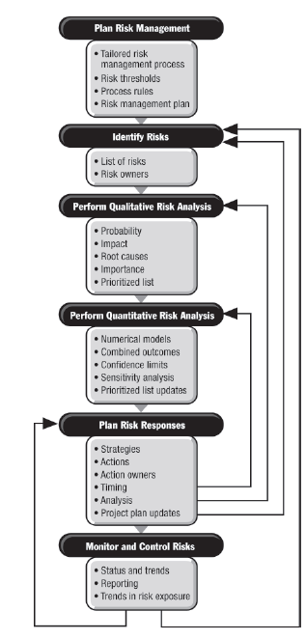
From Practice Standard for Project Risk Management, 1st Ed, PMI

Slide 51
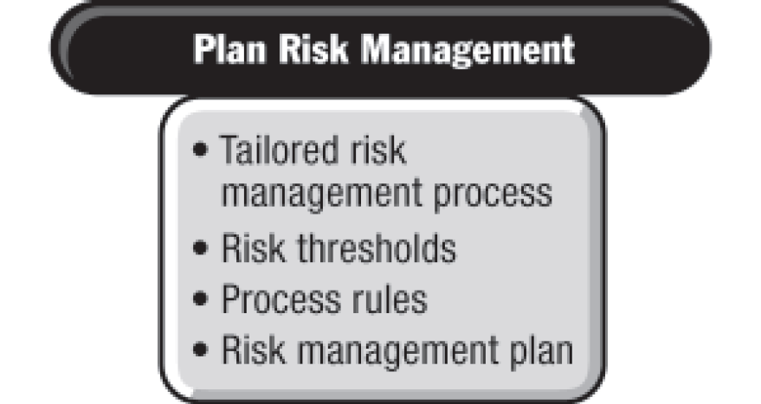
From Practice Standard for Project Risk Management, 1st Ed, PMI

Slide 52
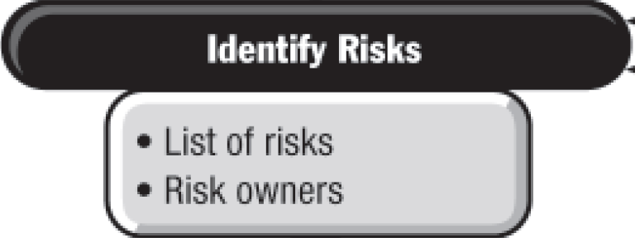
From Practice Standard for Project Risk Management, 1st Ed, PMI

Slide 53
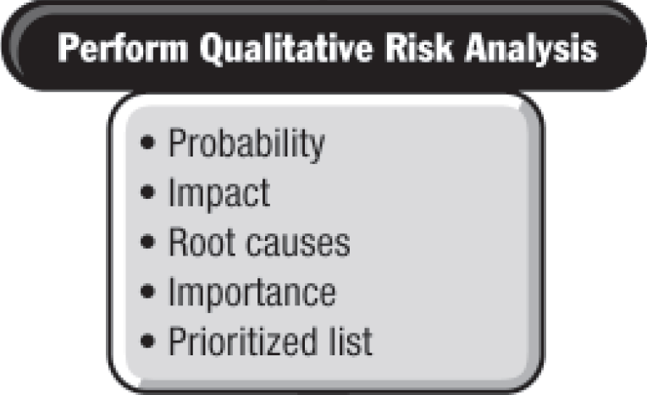
From Practice Standard for Project Risk Management, 1st Ed, PMI

Slide 54
From Practice Standard for Project Risk Management, 1st Ed, PMI

Slide 55
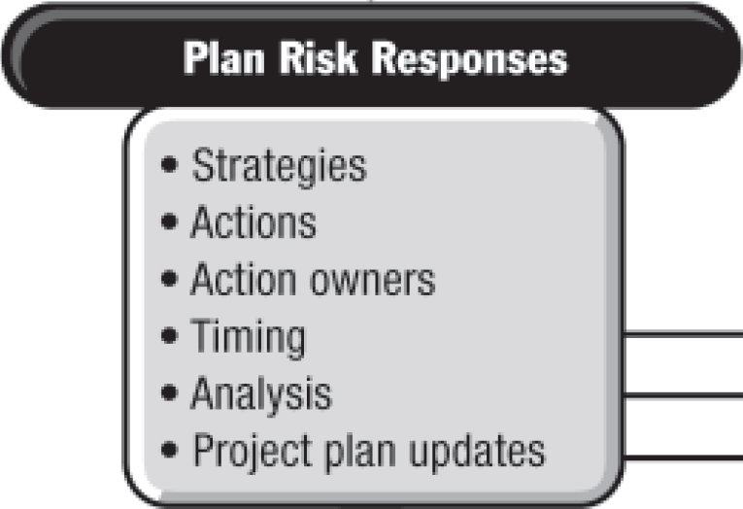
From Practice Standard for Project Risk Management, 1st Ed, PMI

Slide 56
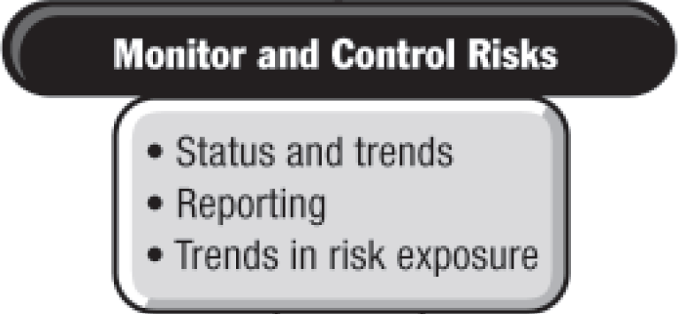
From Practice Standard for Project Risk Management, 1st Ed, PMI

Slide 57
UNIT 3
Review Questions

Slide 58
The End
THE END
THANK YOU

